Slide 1
Summary Results Emissivity
23/08/2021

Slide 2
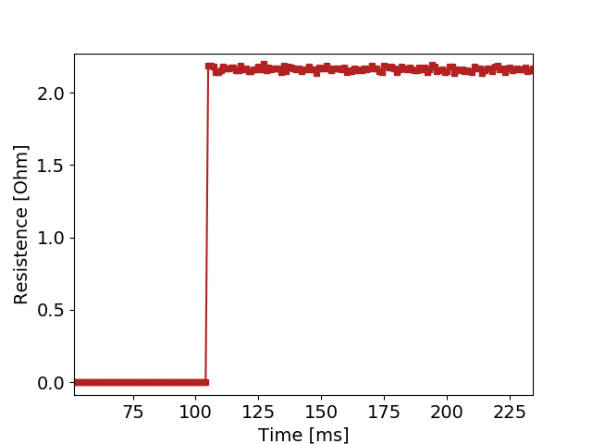
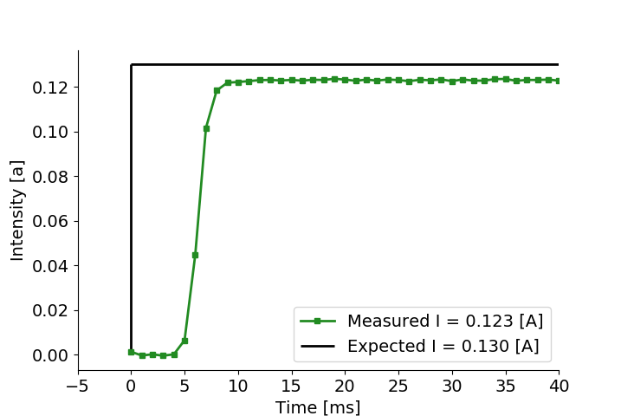
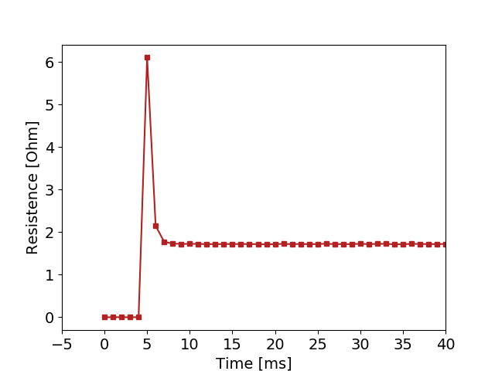
Current, Voltage, Resistance Measurements.
Example of R0 measurement. One can see, expected power load, Real power load, and measured R0.
In this case, we can see a resistance overshoot. This is due to the small values of the intensity. R = V/I If we limit good values to I > 40 mA this disappears.

Slide 3
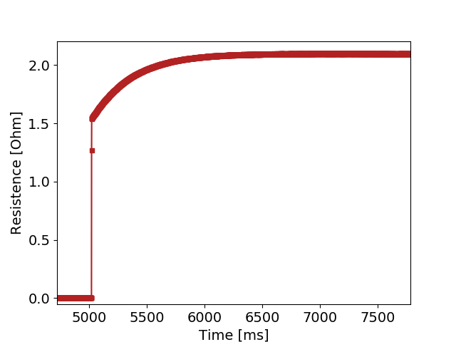
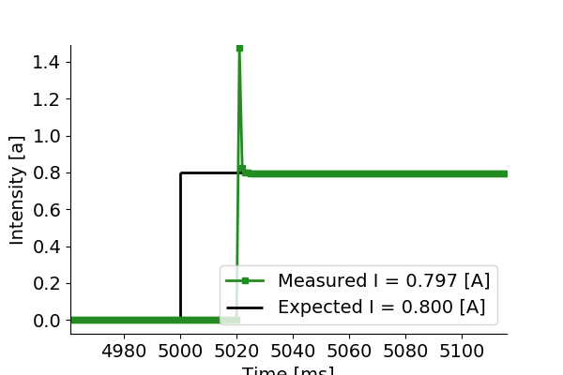
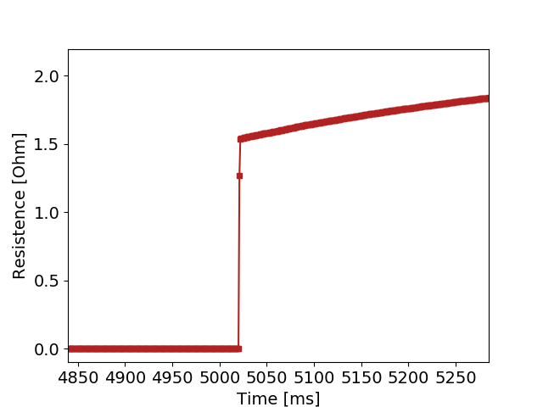
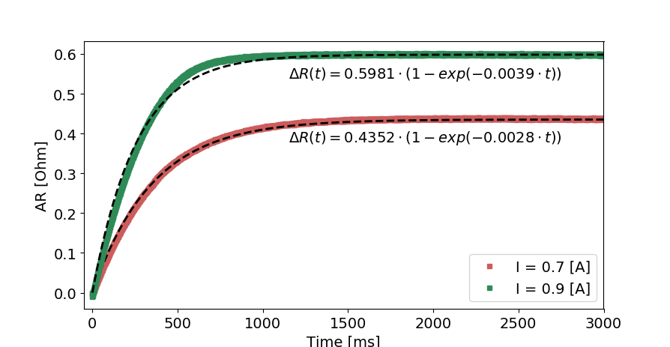
Current, Voltage, Resistance Measurements.
Example of R measurement. One can see, expected power load, Real power load, and measured R. We can see an intensity overshoot and then it stabilizes to the correct value…. It is part of the source or the circuit. Try to find out. Either way the measurement of R seems to be correctly done. We can clearly see the Transient state the resistance. This is not the intensity source transient as it that one is much shorter.
This transient state can be fitted by this formula:
AR (t) = a *(1-exp(-t/b**b))

Slide 4
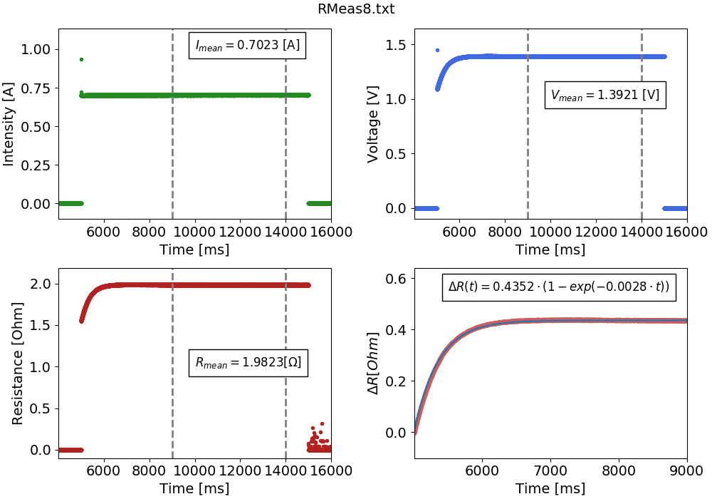
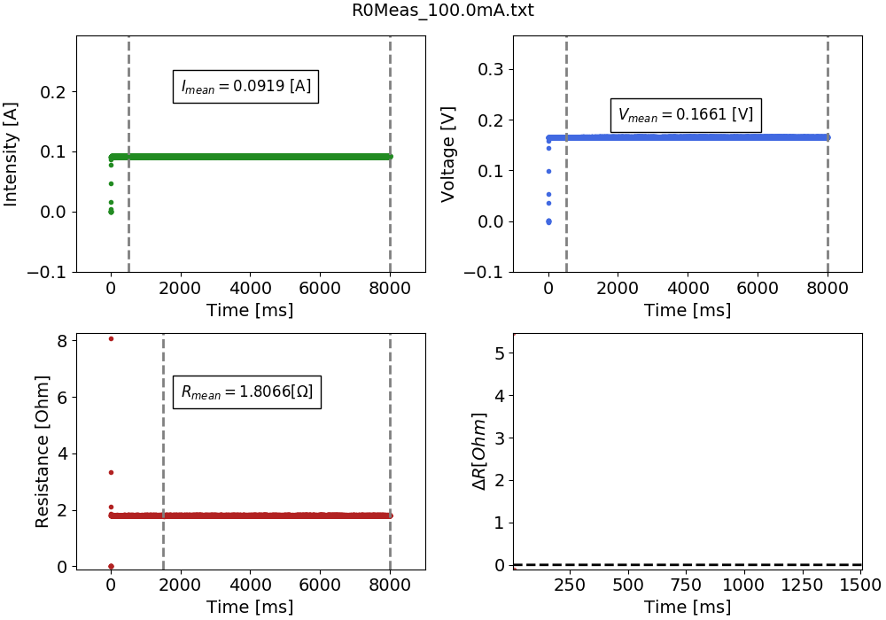
Summary of R0 measurements
Summary of R measurements
Transient state only starts being seen after around 140 or so mA.

Slide 5
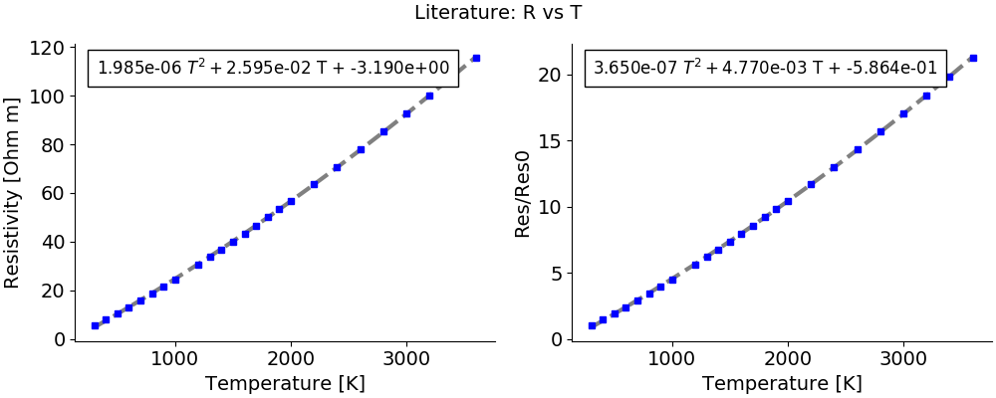
We calculate do the summary plot of the previous slide for all the measurements. And we end up with a summary table. Now, let’s relate intensity to temperature.
1. We take from theory a table that relates temperature with resistance.

Slide 6
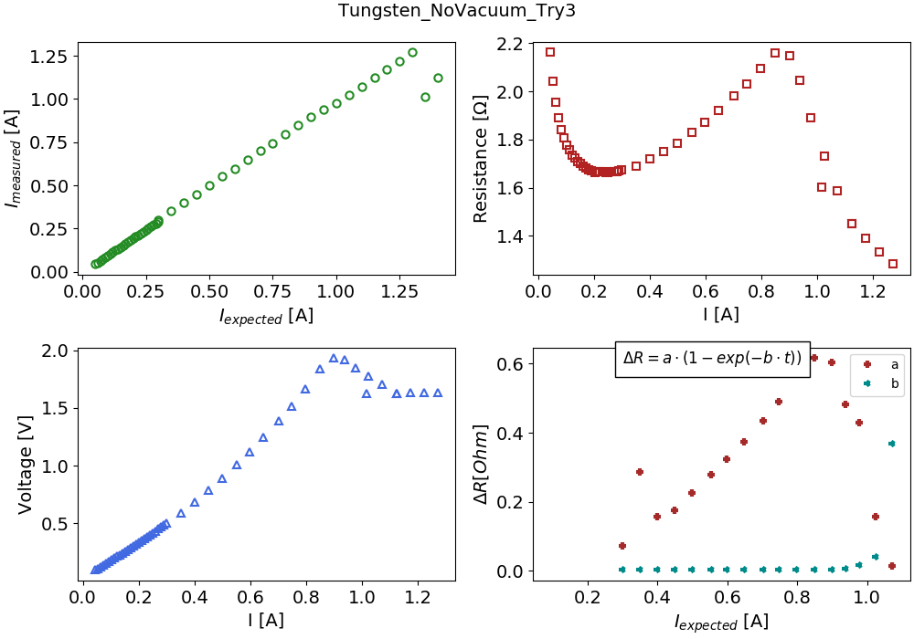
For all the graphs except intensity one, the intensity used is the measured one.
Voltage seems to have a parabolic is behavior, as it is expected for a metal.
Resistance plot is interesting….
What is happening at low intensities?? Is it an effect of the measuring system?
Why does it increase?
Yes, effect of circuit, check Miguel error plot.
What happens at the maximum? Is it due to oxidation?
No, due to circuit ADC limits (vmax = 2.5V) Circuit modified
2. We take the measurements, Intensity vs Resistivity.

Slide 7
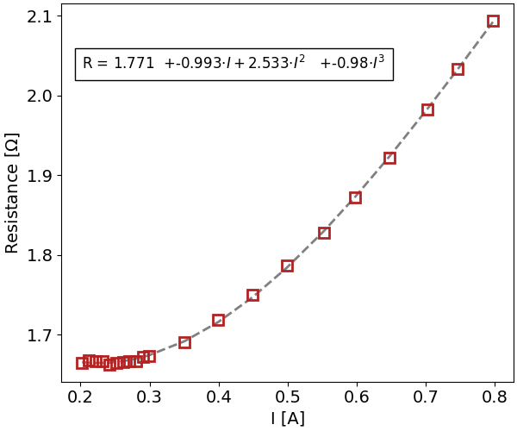
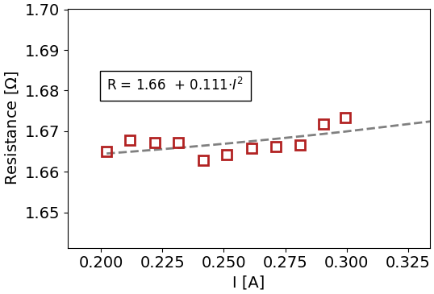
Let’s take a closer look. Only check from 0.2 A to 0.9 A.
From here we can calculate R0 by doing a parabolic approximation of the points close to 0.
R = R0 + A* I ^2 -> R0 = 1,659 [Ohm]
This approximation is given in the article. May be another one would be better?

Slide 8
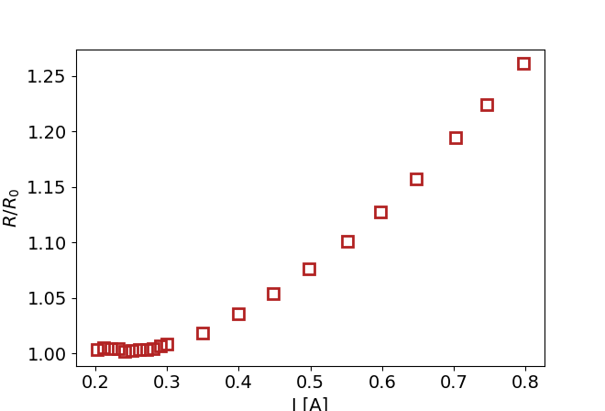
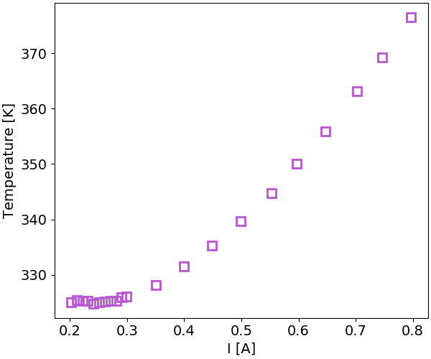
Now let’s calculate a plot relating Intensity applied and temperature.
If we assume cross section and wire length constant for all intensities….
Measured
This is not true but for first approximation.
W solve the following second order equitation:
R/R0_meas = 3,65e-7T^2+4,77e-3*T – 5,864e-1
To calculate T
Literature

Slide 9
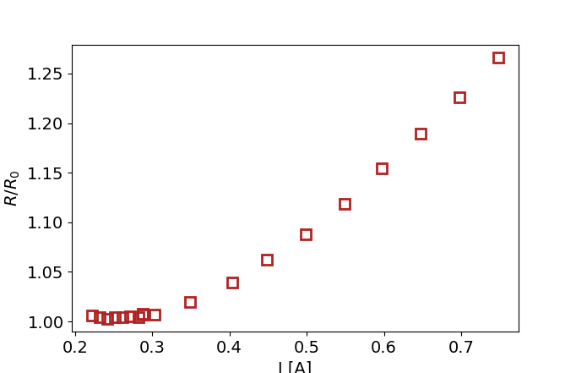
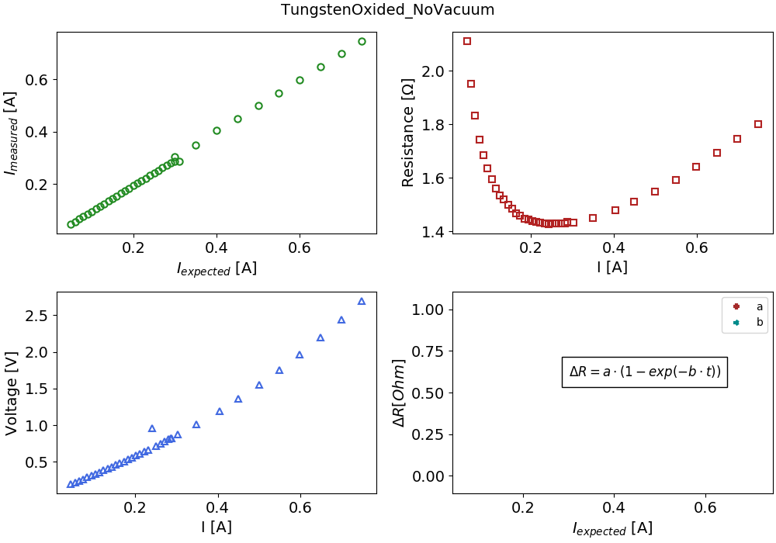
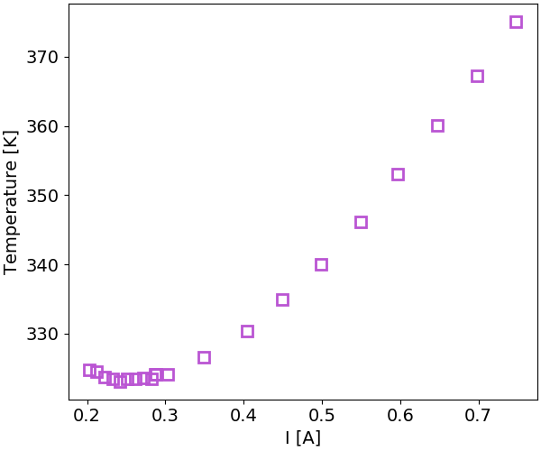
A voltage divisor has been added. Now It should be able to arrive up to 3,7V but not sure it that is true yet.
Y = 1.4234 + 0.10713*I^2

Slide 10
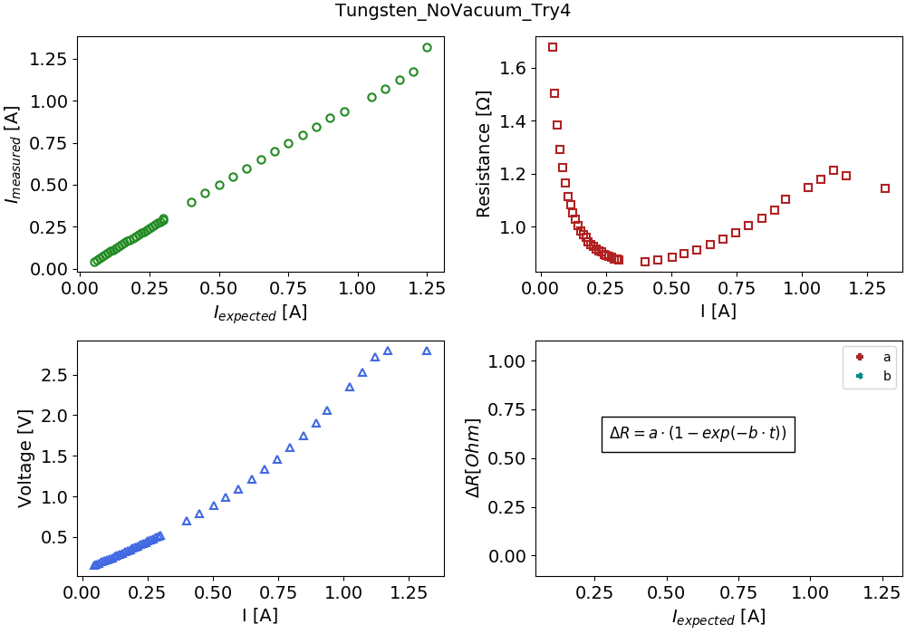
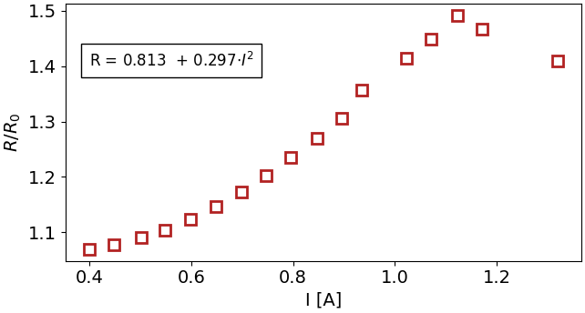
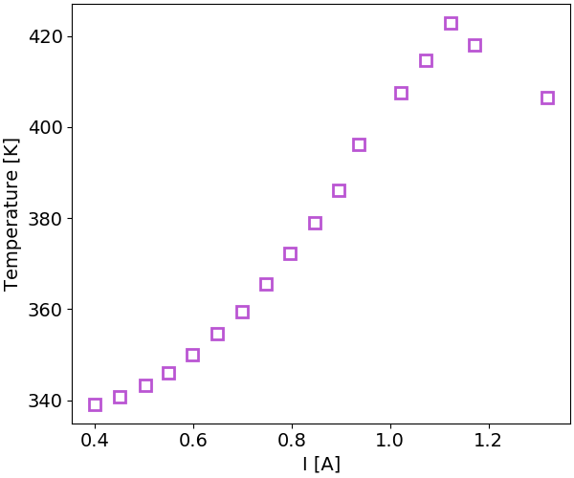
Interesting, but It would be very interesting to be able to reach 6V current….
Offset for ADC was badly set, we could only reach 1.3 ish volts…

Slide 11
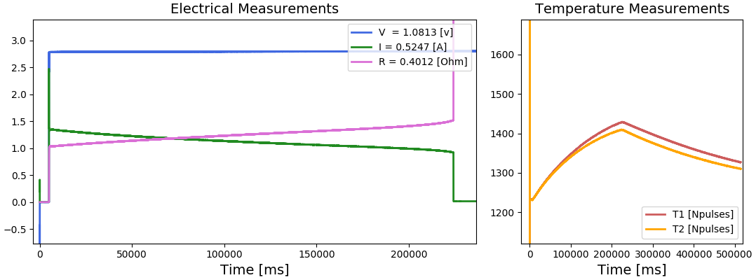
When we put intensities of around 1.450 A the wire breaks. If you do it little by little it starts oxidizing and then breaks. If you put 1,450 a breaks immediately.
This is a plot of the breakage of the wire along time. It did not oxide

Slide 12
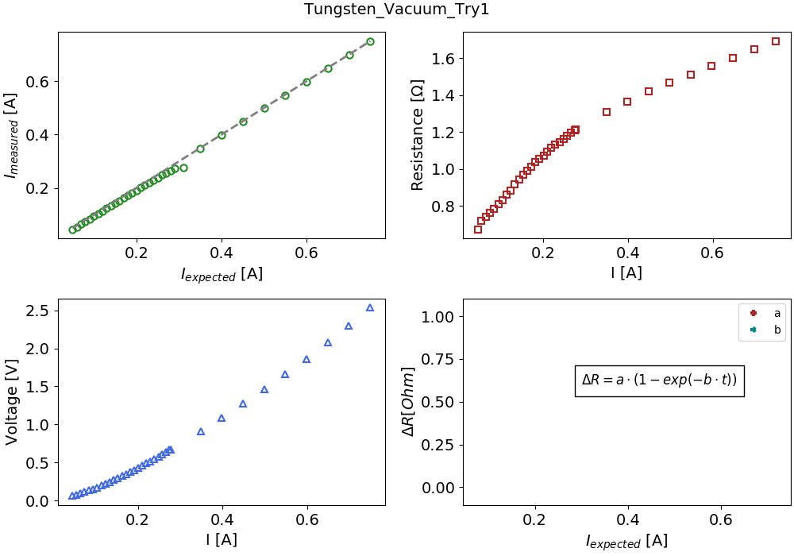
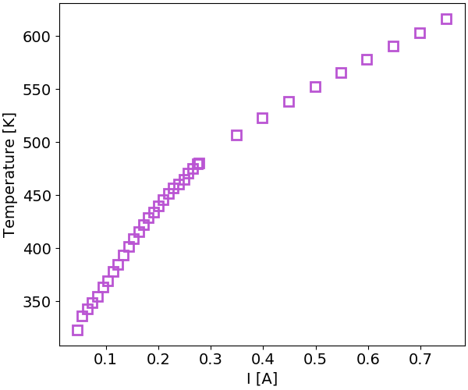
First Tests in vacuum…..
There are two very different slopes….. What is happening….?

Slide 13
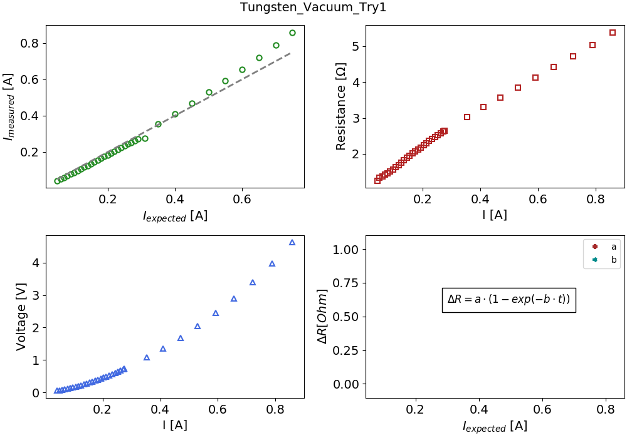
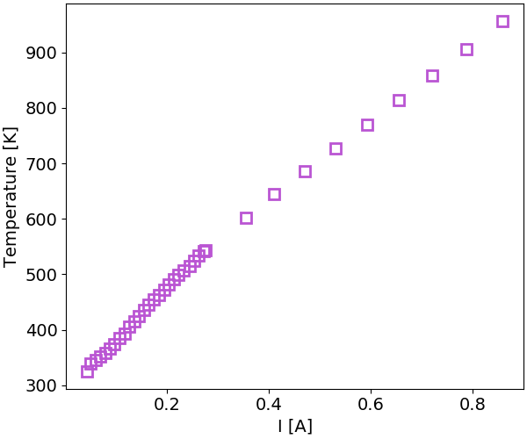
After Calibration ……

